Slide 1
Introduction of Mac Address, IP addresses, Subnet Mask, Network Classes : A, B, C, D, E
Department of Computer Science and Engineering
Chitkara University, Punjab

Slide 2
MAC Address
Media Access Control (MAC) address is a physical address that works at the data link layer of the OSI model.
A MAC address is a 48 or 64-bit address associated with a network adapter.
MAC addresses are linked to the hardware of the network adapters, hence they are also known as the "hardware address" or "physical address.“
MAC addresses uniquely identify the adapter on the LAN.
MAC addresses are expressed in hexadecimal notation. For example, "01-23-45-67-89-AB" in a 48-bit address or "01-23-45-67-89-AB-CD-EF" in a 64-bit address. Sometimes, colons (:) are used instead of dashes (-).
MAC addresses are often considered permanent, but in some conditions, they can be changed.

Slide 3
systems and locations where device's MAC is stored – ipconfig /all
Device's Network Interface Card (NIC): The MAC address is typically burned into the NIC's firmware or stored in its memory.
Device's Operating System: The OS stores the MAC address in its network settings or configuration files (e.g., Windows Registry, Linux's /etc/network/interfaces).
DHCP Server: When a device receives an IP address from a DHCP server, its MAC address is stored in the DHCP server's database.
Router's ARP Table: Routers store MAC addresses in their ARP (Address Resolution Protocol) tables to map IP addresses to MAC addresses.
Switches and Bridges: These devices store MAC addresses in their CAM (Content-Addressable Memory) tables to forward packets to the correct ports.
Wi-Fi Access Points: Wi-Fi access points store MAC addresses of connected devices in their association tables.
Network Management Systems: NMSs, like SNMP (Simple Network Management Protocol) servers, store MAC addresses for network monitoring and management purposes.
Firewalls and Security Appliances: Some firewalls and security appliances store MAC addresses to enforce security policies or filter traffic.

Slide 4
Contd…
There are three types of MAC addresses :
1. Unicast MAC Address
2. Multicast MAC address
3. Broadcast MAC address
MAC Address Format:
A 48-bit MAC address is represented as a string of six octets, "MM:MM:MM:SS:SS:SS".
The first half (24 bits) of the MAC address contains the ID number of the adapter manufacturer. These IDs are regulated by an Internet standards organization.
The second half (24 more bits) of the MAC address represents the serial number assigned to the adapter by the manufacturer.

Slide 5
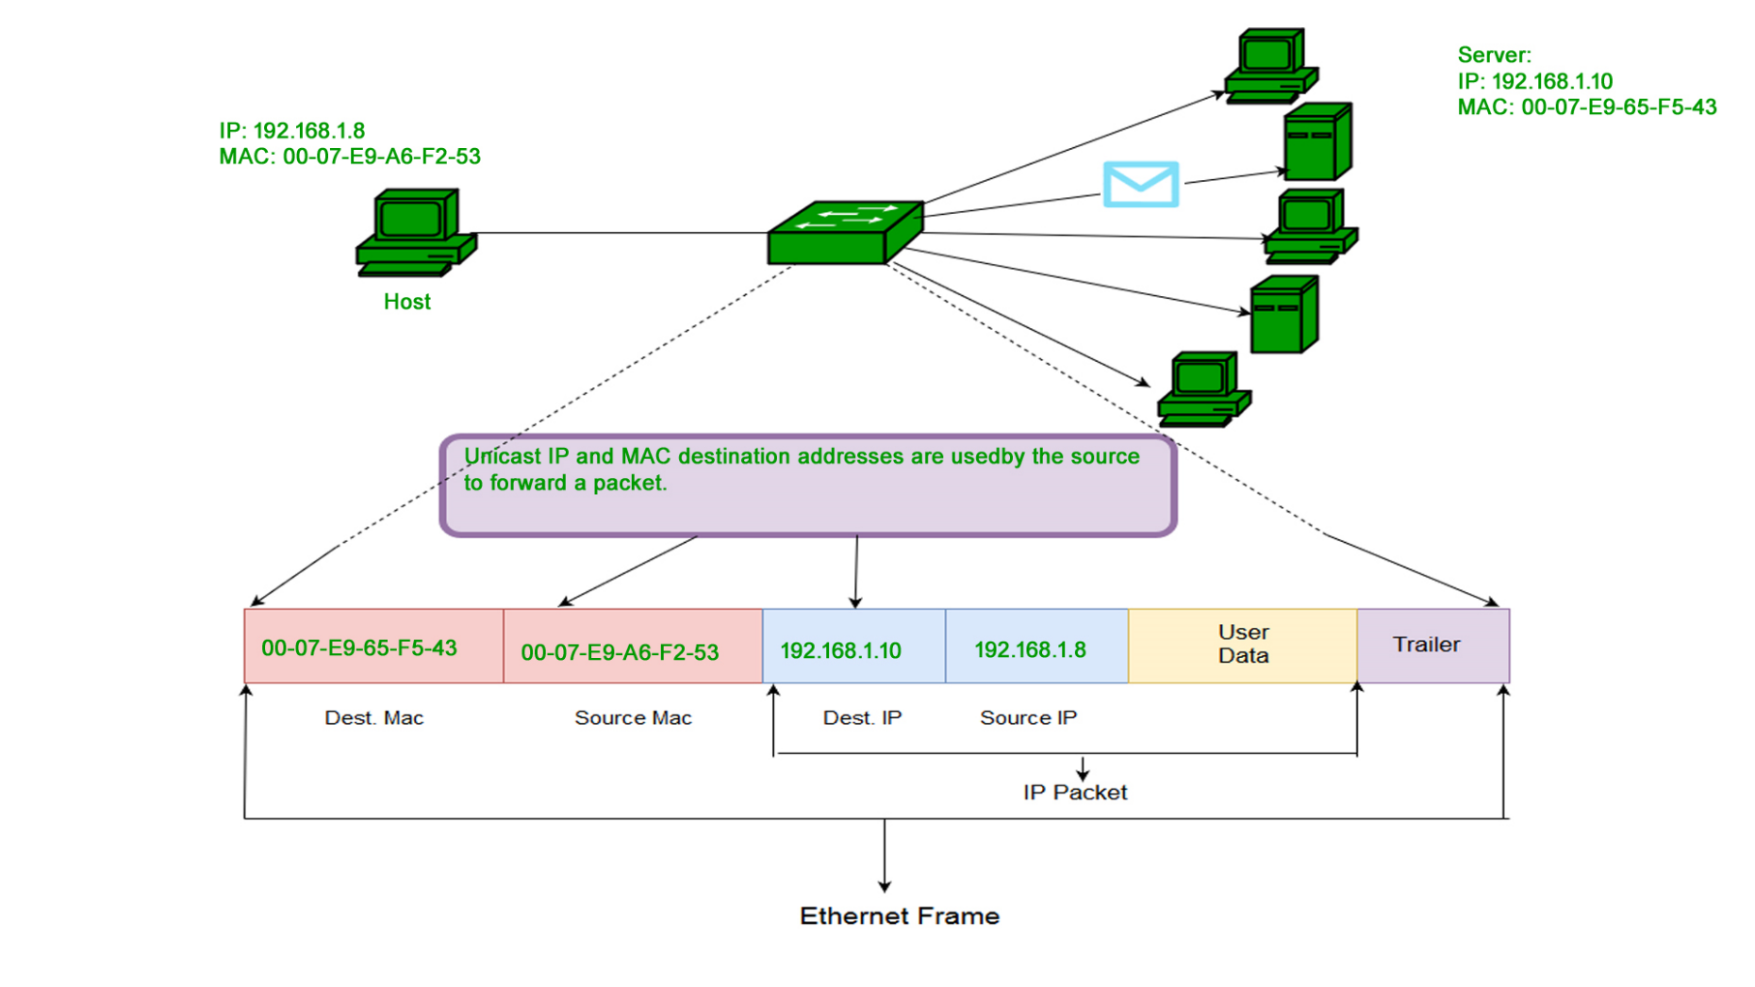
UNICAST

Slide 6
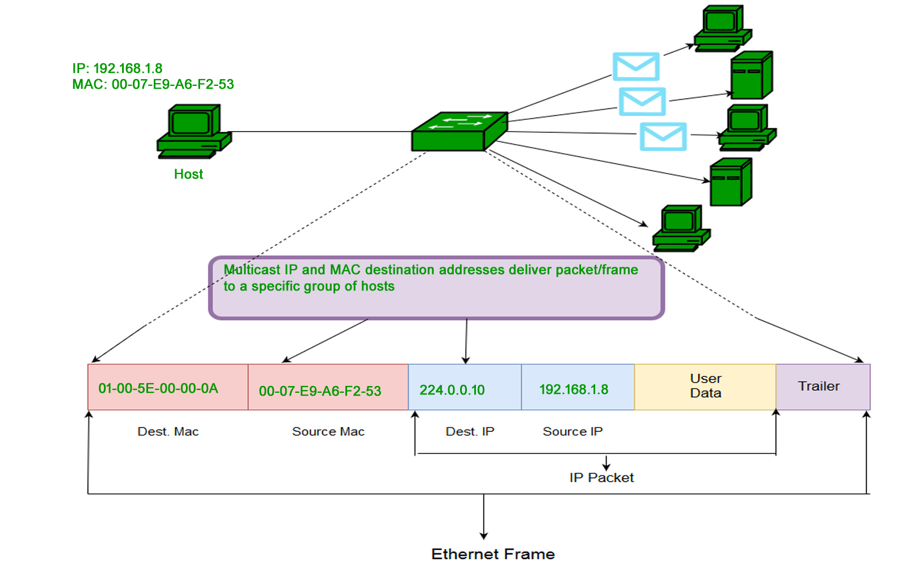
MULTICAST

Slide 7
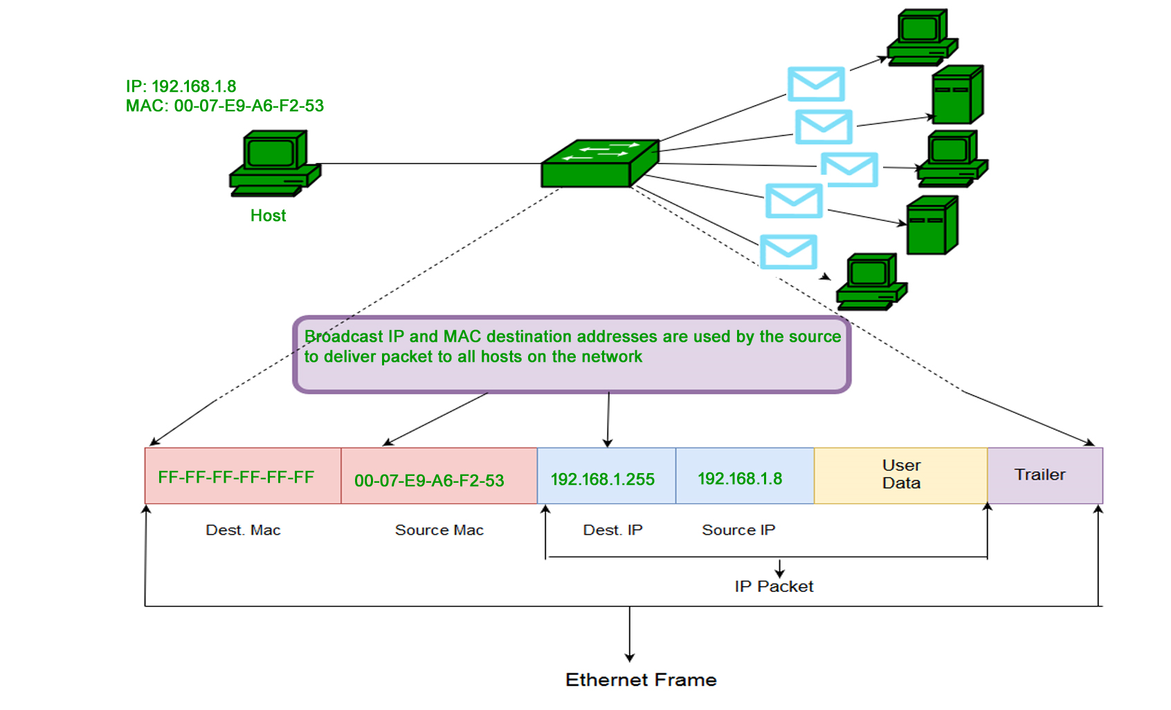
BROADCAST

Slide 8
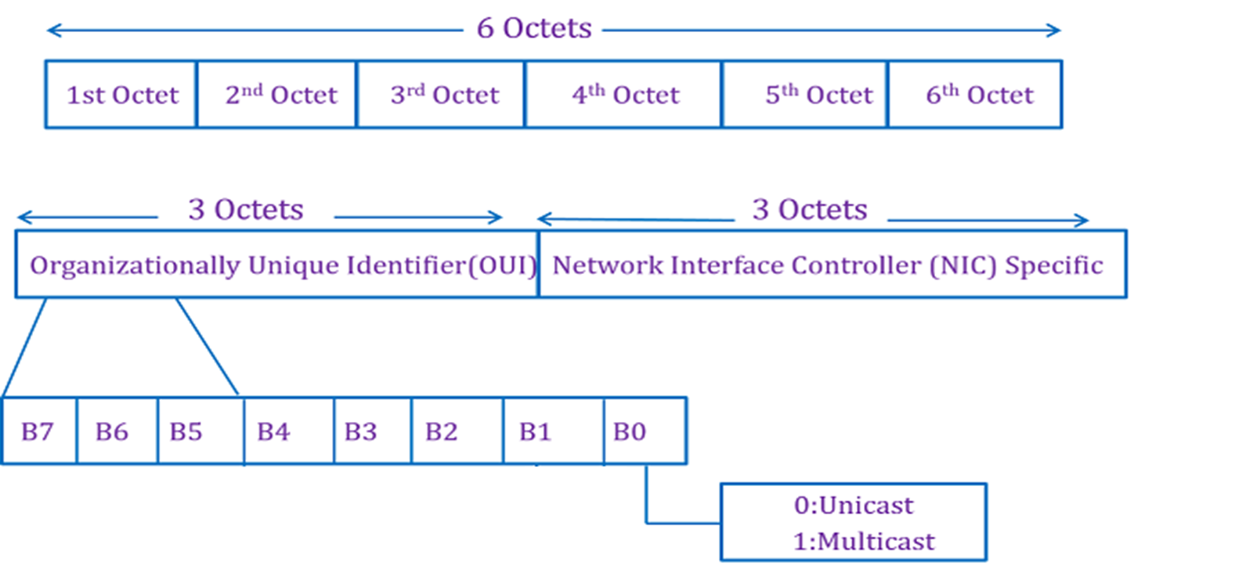
Contd…

Slide 9
Contd…
The OUI (Organizational Unique Identifier) for the manufacture of this router is the first three octets ("00-A0-C9") is Intel corporation and the rightmost six digits represent the Network Interface Controller.
OUIs of some well-known manufacturers:
1. "00-14-22" – Dell
2. "00-04-DC" – Nortel
3. "3C:5A: B4" – Google, Inc.

Slide 10
IP addresses
An IP address represents a unique address that distinguishes any device on the internet or any network from another. IP or Internet Protocol defines the set of commands directing the setup of data transferred through the internet or any other local network.
An IP address is the identifier that enables your device to send or receive data packets across the internet. It holds information related to your location and therefore making devices available for two-way communication.
An IP address is represented by a series of numbers segregated by periods(.). They are expressed in the form of four pairs - an example address might be 255.255.255.255 wherein each set can range from 0 to 255.

Slide 11
Contd…
IP addresses are not produced randomly. They are generated mathematically and are further assigned by the IANA (Internet Assigned Numbers Authority), a department of the ICANN.
Types of IP addresses:
Consumer IP addresses: Every individual or firm with an active internet service system pursues two types of IP addresses, i.e., Private IP (Internet Protocol) addresses and public IP (Internet Protocol) addresses. The public and private correlate to the network area.
Private IP addresses: All the devices that are linked with your internet network are allocated a private IP address. It holds computers, desktops, laptops, smartphones, tablets, or even Wi-Fi-enabled gadgets such as speakers, printers, or smart Televisions.

Slide 12
Contd…
Public IP addresses: A public IP address or primary address represents the whole network of devices associated with it. Every device included within with your primary address contains their own private IP address. ISP is responsible to provide your public IP address to your router. It can be further classified as:
Dynamic IP addresses: As the name suggests, Dynamic IP addresses change automatically and frequently. With this types of IP address, ISPs already purchase a bulk stock of IP addresses and allocate them in some order to their customers. Periodically, they re-allocate the IP addresses and place the used ones back into the IP addresses pool so they can be used later for another client. The foundation for this method is to make cost savings profits for the ISP.

Slide 13
Contd…
Static IP addresses: In comparison to dynamic IP addresses, static addresses are constant in nature. The network assigns the IP address to the device only once and, it remains consistent. Though most firms or individuals do not prefer to have a static IP address, it is essential to have a static IP address for an organization that wants to host its network server. It protects websites and email addresses linked with it with a constant IP address.

Slide 14
Subnet mask
A subnet mask is a 32-bit number created by setting host bits to all 0s and setting network bits to all 1s. In this way, the subnet mask separates the IP address into the network and host addresses.
The “255” address is always assigned to a broadcast address, and the “0” address is always assigned to a network address. Neither can be assigned to hosts, as they are reserved for these special purposes.
The IP address, subnet mask and gateway or router comprise an underlying structure—the Internet Protocol—that most networks use to facilitate inter-device communication.
When organizations need additional subnetworking, subnetting divides the host element of the IP address further into a subnet.

Slide 15
Contd…
IP address and Subnet Mask: A 32-bit IP address uniquely identifies a single device on an IP network. The 32 binary bits are divided into the host and network sections by the subnet mask but they are also broken into four 8-bit octets. Because binary is challenging, we convert each octet so they are expressed in dot decimal. This results in the characteristic dotted decimal format for IP addresses—for example, 172.16.254.1. The range of values in decimal is 0 to 255 because that represents 00000000 to 11111111 in binary.
How does Subnet Mask works: Subnetting is the technique for logically partitioning a single physical network into multiple smaller sub-networks or subnets. Subnetting enables an organization to conceal network complexity and reduce network traffic by adding subnets without a new network number.

Slide 16
Contd…
The benefits of subnetting include:
1. Reducing broadcast volume and thus network traffic.
2. Allowing organizations to surpass LAN constraints such as maximum number of hosts.

Slide 17
Problem on Subnet
Ques. For subnet masks 255.255.255.240 find-
a. Number of hosts per subnet
b. Number of subnets if subnet mask belongs to class A
c. Number of subnets if subnet mask belongs to class B
d. Number of subnets if subnet mask belongs to class C
e. Number of subnets if total 10 bits are used for the global network ID

Slide 18
Solution
Ans. Given subnet mask is 255.255.255.240
So,
Number of Net ID bits + Number of Subnet ID bits = 28
Number of Host ID bits = 4
Since number of Host ID bits = 4, so- Number of hosts per subnet = 2⁴ – 2
B. If the given subnet mask belongs to class A, then number of Net ID bits = 8.
Substituting in the above equation, we get-
Number of Subnet ID bits = 28 – 8 = 20
Thus,
Number of subnets = 2²⁰

Slide 19
Contd…
C. If the given subnet mask belongs to class B, then number of Net ID bits = 16.
Substituting in the above equation, we get-
Number of Subnet ID bits = 28 – 16 = 12
Thus,
Number of subnets = 2¹²
D. If the given subnet mask belongs to class C, then number of Net ID bits = 24.
Substituting in the above equation, we get-
Number of Subnet ID bits = 28 – 24 = 4
Thus,
Number of subnets = 2⁴

Slide 20
Contd…
E. Given 10 bits are used for the Net ID part.
Substituting in the above equation, we get-
Number of Subnet ID bits = 28 – 10 = 18
Thus,
Number of subnets = 2¹⁸
Example:
^{Subnet mask 255.255.}

Slide 21
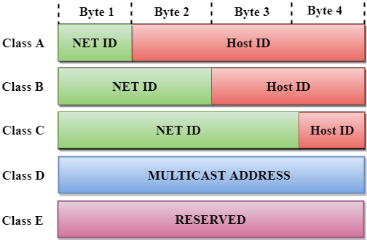
Network classes
An IP address is divided into 2 parts:
1. Network ID: It represents the number of networks.
2. Host ID: It represents the number of hosts.

Slide 22
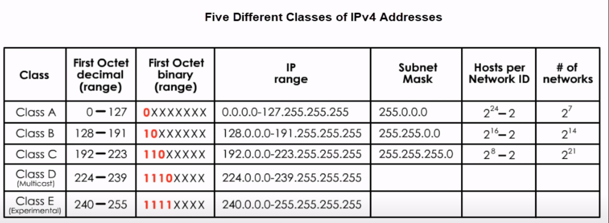

Slide 23

Contd…
1. Class A: In Class A, an IP address is assigned to those networks that contain a large number of hosts.
The network ID is 8 bits long.
The host ID is 24 bits long.
In Class A, the first bit in higher order bits of the first octet is always set to 0 and the remaining 7 bits determine the network ID. The 24 bits determine the host ID in any network.
The total number of networks in Class A = 2⁷ = 128 network address
The total number of hosts in Class A = 2²⁴ - 2 = 16,777,214 host address

Slide 24

Contd…
2. Class B: In Class B, an IP address is assigned to those networks that range from small-sized to large-sized networks.
The Network ID is 16 bits long.
The Host ID is 16 bits long.
In Class B, the higher order bits of the first octet is always set to 10, and the remaining14 bits determine the network ID. The other 16 bits determine the Host ID.
The total number of networks in Class B = 2¹⁴ = 16384 network address
The total number of hosts in Class B = 2¹⁶ - 2 = 65534 host address

Slide 25

Contd…
3. Class C: In Class C, an IP address is assigned to only small-sized networks.
The Network ID is 24 bits long.
The host ID is 8 bits long.
In Class C, the higher order bits of the first octet is always set to 110, and the remaining 21 bits determine the network ID. The 8 bits of the host ID determine the host in a network.
The total number of networks = 2²¹ = 2097152 network address
The total number of hosts = 2⁸ - 2 = 254 host address

Slide 26


Contd…
4. Class D: In Class D, an IP address is reserved for multicast addresses. It does not possess subnetting. The higher order bits of the first octet is always set to 1110, and the remaining bits determines the host ID in any network.
5. Class E: In Class E, an IP address is used for the future use or for the research and development purposes. It does not possess any subnetting. The higher order bits of the first octet is always set to 1111, and the remaining bits determines the host ID in any network.

